Slide 1
Introduction to Object-Orientation
BACS2023 Object-Oriented Programming
Chapter 1

Slide 2
Learning Outcomes
At the end of this chapter, you should be able to :
Explain what is structured design
Describe the object-oriented design approach
Write a simple program that uses an object for console input

Slide 3
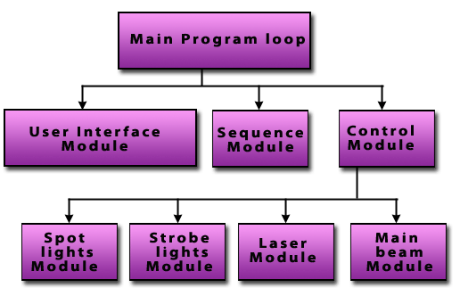
1. Structured Design
Dividing a problem into smaller subproblems is called structured design.
The structured design approach is also known as :
  top-down design
  stepwise refinement
  modular programming

Slide 4
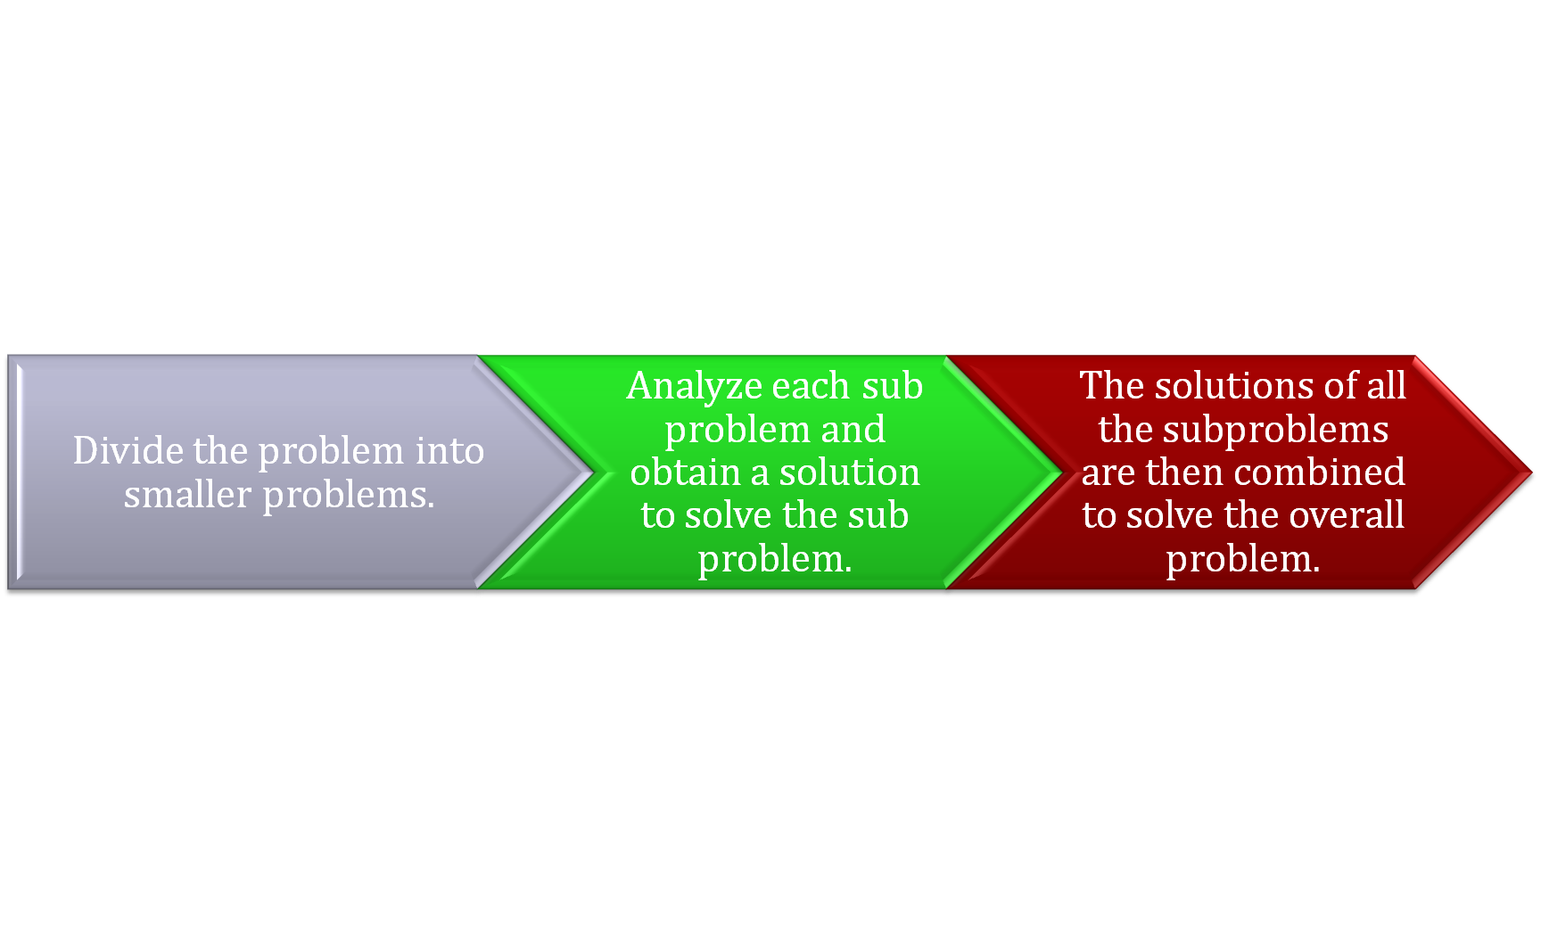
How Structured Design Works
Structured programming : The process of implementing a structured design.

Slide 5
Step 1
Structured Design
Step 2
Huge Problem
Solution
Solution
Solution
Small Problem
Small Problem
Small Problem
Step 3
Solution
Solution
Solution
Complete Solution

Slide 6



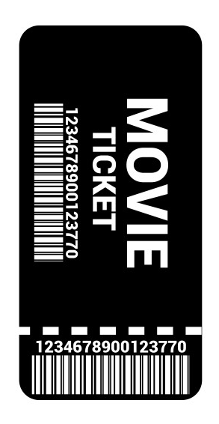
2. Object-Oriented Design
Object:
a thing that has physical existence or significance
any real world entity which can have some characteristics
or which can perform some n tasks

Slide 7
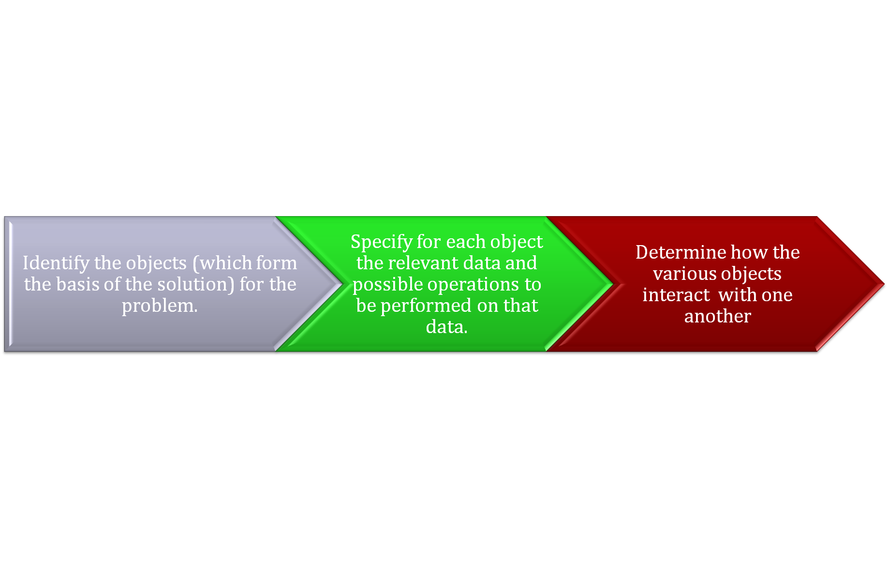
2. Object-Oriented Design
In object-oriented design (OOD), the steps in the problem-solving process include-

Slide 8


OOD Example
Suppose you want to write a program that automates the video rental process for a local video store.
What are the two main objects in this problem ?
?
Video
?
Customer

Slide 9
Example of Data
Movie name
Actors
Producer
Production company
Number of copies in stock
etc

Slide 10
Examples of operations
Checking the name of the movie
Reducing the number of copies in stock by one after a copy is rented
Incrementing the number of copies in stock by one after a customer returns a copy

Slide 11
Object Characteristics
Each object consists of data and operations on the data.
In OOD, the final program is a collection of interacting objects.
A programming language that implements OOD is called an object-oriented programming (OOP) language.

Slide 12
OOD’s 3 basic principles
Encapsulation – all about wrapping variables and methods in one single unit with the sole purpose of data hiding from external classes.
Inheritance – the ability to create new (data) types from existing (data) types.
Polymorphism – the ability to use the same expression to denote different operations.

Slide 13
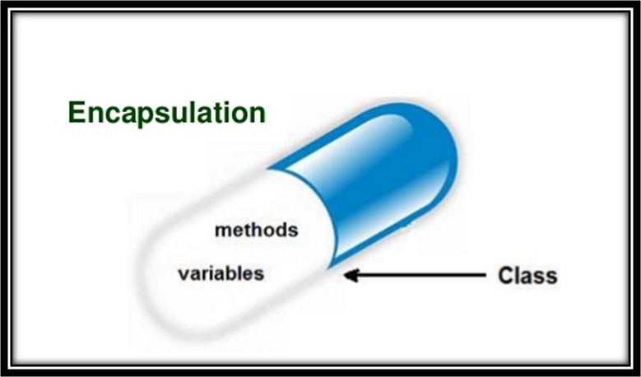
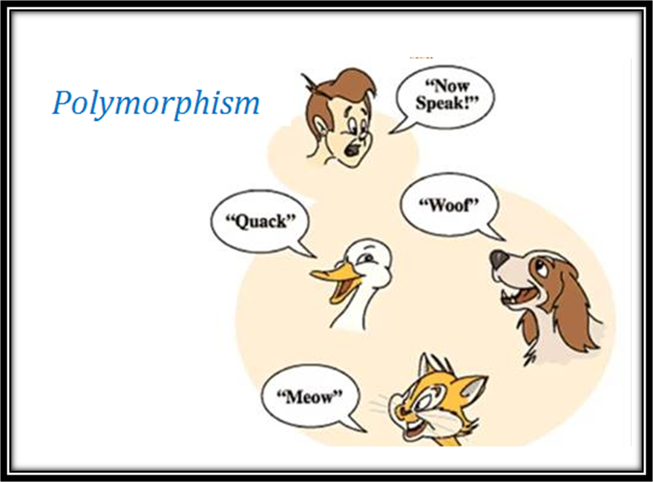

OOD basic principles

Slide 14
Classes
A class is an entity that determines how an object will behave and what the object will contain.
Classes are used to create and manage new objects
In OOP languages (e.g. Java, C++), encapsulation is accomplished via the use of the data types called classes.
In OOD, you decide which classes you need and what are their relevant data fields (variables) and methods (functions for the operations).

Slide 15
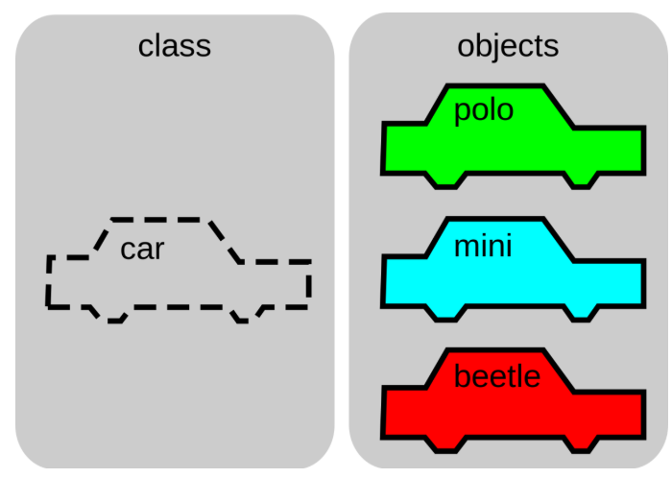
Classes

Slide 16
Implementation
In the implementation phase of the software development process, you write and compile programming code to implement the classes and methods that were discovered in the design phase.
This course uses the OOD technique (in conjunction with structured programming) to solve problems.

Slide 17
Object-oriented Programs
The final OO program consists of objects and methods.
Methods are designed to accomplish a specific task.
  Some methods are part of the main program; others are used to implement various operations on methods.
Objects interact with each other via method calls.

Slide 18
Java
One of the OOP Language
C++ , C#, Vb.net, etc
Other OOP Language

Slide 19
Intro to Java, an OOP language
At the end of this session, you should be able to :
Use Java data types.
Write i/o statements.
Use the standard Java naming convention in programs.

Slide 20
Self-Review by Students
Appendix A1 Introduction to Java provides a brief intro to the language
Revise your C or C++ programming topics using
  Appendix A2 Elementary Programming
  Appendix A3 Selections
  Appendix A4 Loops
We will only go through parts of elementary programming which are different in Java

Slide 21
The Java Syntax
The Java syntax is very similar to the C Language.
C | Java
Similar:
#include<stdio.h>
int main(void) {}
int x; printf(“X = %d\n ”, x); | int x;
int x; scanf(“%d”, &x); | int x;
Different:
char c[] = “Love”; -------------------------- c | L| o | v | e | \0 | -------------------------- | String s = “Love”; s

Slide 22
Java operators
Java provides a rich set of operators to manipulate variables. We can divide all the Java operators into the following groups:
(+, -, *, /, %, ++, --)
Arithmetic Operators
Relational Operators
Bitwise Operators
Logical Operators
Assignment Operators
Misc Operators
(==, !=, >, <, >=, <=)
(&, |, ^, ~, <<, >>, >>>)
(&&, ||, !)
(=, +=, -=, *=, /=, %=, <<=, >>=, &=, ^=, |=)
(Conditional Operator ( ? : ), instanceOf Operator)

Slide 23
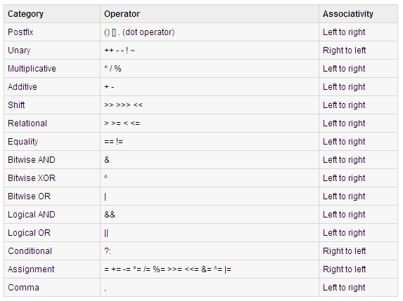
Precedence of Java Operators:

Slide 24
Rules for Java Identifiers
Can only use:
  Letters
  Digits
  Underscores (_)
  Dollar sign ($).
Must start with
  a letter
  an underscore (_), or
  a dollar sign ($)
Can be of any length.
Cannot be
  a reserved word (see Appendix A of textbook list of Java reserved words).
  true, false, null
Note: Java is case-sensitive

Slide 25
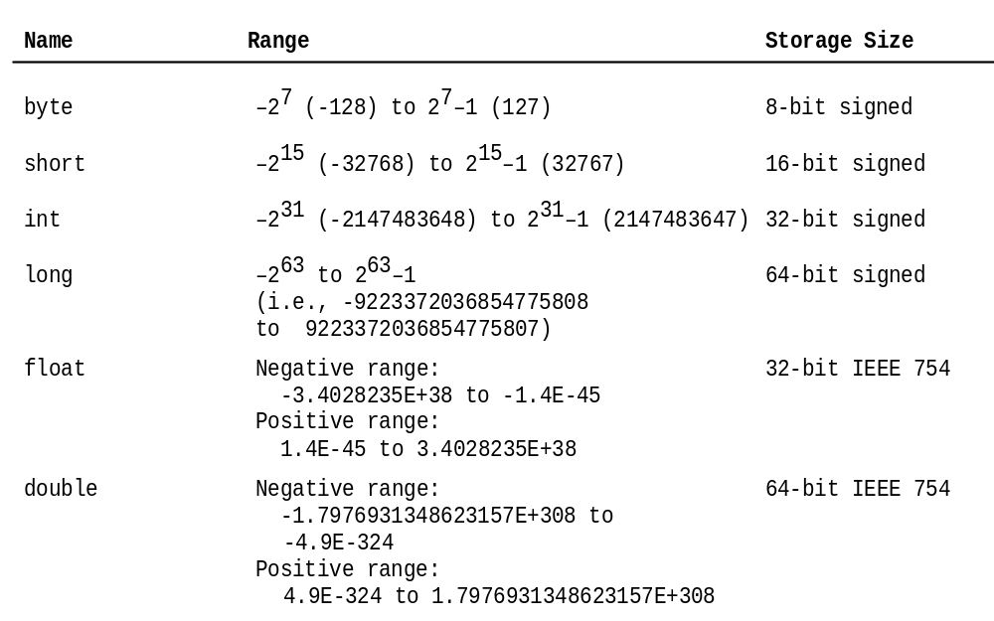
Java Numerical Data Types

Slide 26
Using Methods
In order to use a method, the user needs to know only
  how to use the method and
  what the method does
The user should not be concerned with the details of the method, i.e. how the method is written.

Slide 27
Example: The Scanner class
The Scanner class is a predefined class in the Java library for handling console input.

Slide 28
Console Input
1. Create a Scanner object
  Scanner scanner = new Scanner(System.in);
Use the methods next(), nextByte(), nextShort(), nextInt(), nextLong(), nextFloat(), nextDouble() or nextBoolean() to obtain to a string, byte, short, int, long, float, double, or boolean value.
Example:
  System.out.print("Enter a double value: ");
  Scanner scanner = new Scanner(System.in);
  double d = scanner.nextDouble();

Slide 29
Sample Program for Console Input
TestScanner.java
Tip:
Benefit of using console input: we can have input and output re-direction.
Input re-direction
  Store input values in a text file and pass the file from the command line using the “<“ symbol as follows:
    C:\java TestScanner < input.txt
Output re-direction is also possible
  C:\java TestScanner < input.txt > out.txt

Slide 30
Console output: System.out methods
Method | Description
void print(char c) | Print a character
void print(int i) | Print an integer
void print(double d) | Print a double value
void print(String s) | Print a string.
void println() | Terminate the current line by writing the line separator string (usually a single newline character ‘\n’.
void println(char c) | Print a character and then terminate the line.
void println(int i) | Print an integer and then terminate the line.
void println(double d) | Print a double value
void println(String s) | Print a string and then terminate the line.

Slide 31
Comparing numeric types’ range
Type Casting
Range increases
byte, short, int, long, float, double

Slide 32
Examples of Type Casting
  double d = 3;
  int i = (int)3.0;
  int i = (int)3.9;
  int x = 5 / 2.0;
For each example above:
Is it implicit or explicit casting?
Is it type widening or type narrowing?
What value is assigned to the variable?
Notes:
Implicit casting
double d = 3; (type widening) – automatic type conversion from int to double
Explicit casting
int i = (int)3.0; (type narrowing) – explicit type casting from double to int
int i = (int)3.9; (Fraction part is truncated) – explicit type casting from double to int
What is wrong? int x = 5 / 2.0;
Note: there will be error as the expression’s type is double and assigning a double value to an integer variable is type narrowing, which requires explicit casting.
byte, short, int, long, float, double
Bits: 8 16 32 64 32 64

Slide 33
Numeric Type Conversion
Consider the following statements:
byte i = 100;
long k = i * 3 + 4;
double d = i * 3.1 + k / 2;
An integer literal is by default of the int type.
An integer literal can be assigned to an integer type (byte, short, int) without explicit casting as long as it can fit into the variable.

Slide 34
What is a constant?
Why use constants?
Notes:
Easier to maintain
Improves readability
Reduces errors – ensures correctness
Consistency
Better programming style

Slide 35
Syntax for Defining Constants
final <datatype> <CONSTANTNAME> = <VALUE>;
Example:
final int MAX = 300;

Slide 36
Character Data Type (1)
char letter = 'A'; (ASCII)
char numChar = '4'; (ASCII)
char letter = '\u0041'; (Unicode)
char numChar = '\u0034'; (Unicode)
Four hexadecimal digits.
Java characters use Unicode.
Unicode
  16-bit encoding scheme
  Supports the different world languages

Slide 37
Character Data Type (2)
Escape Sequences for Special Characters
Description Escape Sequence Unicode
Backspace \b \u0008
Tab \t \u0009
Linefeed \n \u000A
Carriage return \r \u000D
Backslash \\ \u005C
Single Quote \' \u0027
Double Quote \" \u0022

Slide 38
ASCII vs Unicode
ASCII Character Set is a subset of the Unicode from \u0000 to \u007f.

Slide 39

ASCII Character Set
1-<number>

Slide 40
Casting char ↔ numeric types
Casting between char and numeric types is similar as for the C language.
  int i = 'a'; // Same as int i = (int)'a';
  char c = 97; // Same as char c = (char)97;

Slide 41
The boolean Type
Boolean variables may only hold two values:
  true
  false
  Examples:
    boolean b = (1 > 2);
A boolean variable’s value may only be assigned to a boolean variable.
    boolean x = true;
        int y = (int) x; // illegal statement
Notes:
true and false are Java pre-defined boolean literals
In Java, the boolean type is implemented differently from C which uses int.

Slide 42

The String Type
String is a predefined class in the Java library.
Used to represent a string of characters, e.g.
  String message = "Welcome to Java";
Not a primitive type, but a reference type.
Note:
  Any Java class can be used as a reference type for a variable.
  Reference data types will be thoroughly discussed in Chapter 4, “Classes and Objects.”
  For the time being, you just need to know how to declare a String variable, how to assign a string to the variable, and how to concatenate strings.
Notes:
char
The character data type char represents a single character, i.e. a char variable can hold only one character value at any one time.
char literals are enclosed in single quotation marks
String
A string literal must be enclosed in double quotation marks
“A” is a string literal and ‘A’ is a character literal

Slide 43
String Concatenation
Examples
1. Three strings are concatenated
String message = "Welcome " + "to " + "Java";
2. String Chapter is concatenated with number 2
String s = "Chapter" + 2; // s becomes Chapter2
3. String Supplement is concatenated with character B
String s1 = "Supplement" + 'B';
// s1 becomes SupplementB
Notes:
char
The character data type char represents a single character, i.e. a char variable can hold only one character value at any one time.
char literals are enclosed in single quotation marks
String
A string literal must be enclosed in double quotation marks
“A” is a string literal and ‘A’ is a character literal

Slide 44
Formatting Output
Java has a printf method that is similar to C’s. The syntax is
    System.out.printf(format, items);
  where
Example:
  int quantity = 10;
  double salesAmt = 250.80;
  System.out.printf(“Sales: Qty:%d, Amt:RM%.2f\n”, quantity, salesAmt);
format | a string comprising format specifiers (%s, %d)
items | a comma-separated list of numeric, character, boolean or string values

Slide 45
Programming Style & Documentation
Appropriate Comments
Naming Conventions
    Choose meaningful and descriptive names to ensure readability
    See Java naming conventions for variables, method names, class names and constant names
Proper Indentation and Spacing Lines
Block Styles

Slide 46
Appropriate Comments
Include a summary at the beginning of the program to explain what the program does, its key features, its supporting data structures, and any unique techniques it uses.
Include your name, class section, instructor, date, and a brief description at the beginning of the program.

Slide 47
Naming Conventions (1)
Variables and method names:
  Use lowercase.
  If the name consists of several words:
    concatenate all words in one,
    use lowercase for the first word, and
    capitalize the first letter of each subsequent word in the name.
  E.g. of variable names - radius and area
  Eg. of method name - computeArea.

Slide 48
Naming Conventions (2)
Class names
  Capitalize the first letter of each word in the name.
  E.g. the class name ComputeArea.
Constants
  Capitalize all letters in constants, and use underscores to connect words.
  E.g. the constant PI and MAX_VALUE

Slide 49
Proper Indentation and Spacing
Indentation
  Indent two spaces.
Spacing
  Use blank line to separate segments of the code.
public class ComputeArea {
public static void main(String[] args) {
double radius, area;
radius = 20;
area = radius * radius * 3.14159;
System.out.println("The area for the circle of radius " +
radius + " is " + area);
}
}

Slide 50

Block Styles
Use end-of-line style for braces.

Slide 51
Review of learning outcomes
You should now be able to
Explain what is structured design
Describe the object-oriented design approach
Write a simple program that uses an object for console input

Slide 52
To Do
Review the slides and source code for Appendix A1, A2, A3 and A4.
Review the slides and source code for this chapter.
Read up the relevant portions of the recommended text.

